Slide 1
Online Doctor Appointment System
Presented By
TEAM ACS

Slide 2
Responsibilities of Team members
NAVYA KOPPADA –Frontend Developer
SHASHANK KESARI – Frontend + Algorithms
SAI DIVYA SREE ARETI –Backend Developer
VAMSI VURA –Database Management

Slide 3
Project Overview
The Online Doctor Appointment System is a digital platform which empowers patients with the convenience of scheduling appointments in online with doctors efficiently. It serves as a comprehensive repository, maintaining records of patients, doctor details and availability, appointment schedules across all medical centers.
This system enables the smooth registration of new patients, Through the patient user account, individuals can easily book appointments with their preferred doctors and access detailed information about the doctors, including their profiles and available appointment schedule.
Doctor’s can login into the application and can view the list of appointments. Doctor can view the patient’s medical record and also can update the record after consultation. Doctors have the flexibility to adjust their working hours as per the number of scheduled patients for a given day.

Slide 4
Admin can add a new doctor by registering them and admin can also handle the doctor’s details by deleting or editing them. Admin can assign the alternative doctor to a patient if the doctor is unavailable.
The core objective of this project is to develop an application that automates the management of appointment scheduling according to the availability of doctor based on patient requirement. By utilizing this system, manual workload associated with overseeing patient details, appointment bookings, and adjusting the doctor schedules and the waiting time of the patients is significantly reduced ,offering a centralized platform to monitor and track these essential aspects of healthcare management.

Slide 5
Implementations after mid-term
Implemented user bookings page.
Created specialist table.
Implemented appointment list in Doctors page.
Created Admin Dashboard.
Doctor viewing patients/user details.

Slide 6
Technologies Used
JAVA: We have used Java Servlets for implementing the backend.
MySQL: MYSQL database is used to store the data of patients, doctors and appointments.
HTML : We have HTML for designing the UI Screens
Tomcat Server

Slide 7
TECHNICAL COMPONENTS
User Interface (UI)
Database Management System (DBMS)
Authentication and Authorization
Appointment Scheduling Algorithm
Search Functionality
Scalability and Performance Optimization

Slide 8
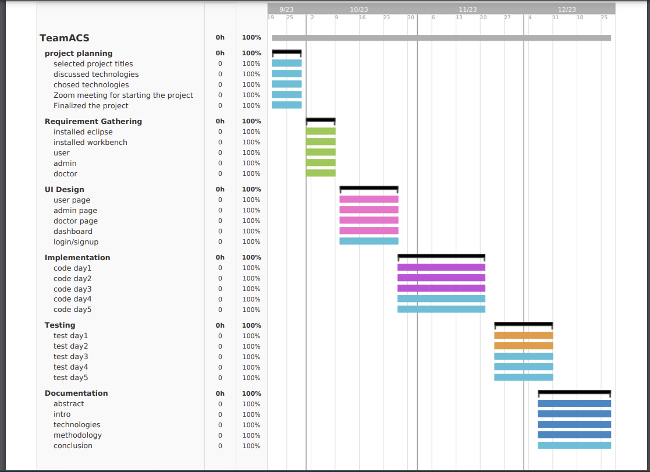
Gantt Chart

Slide 9
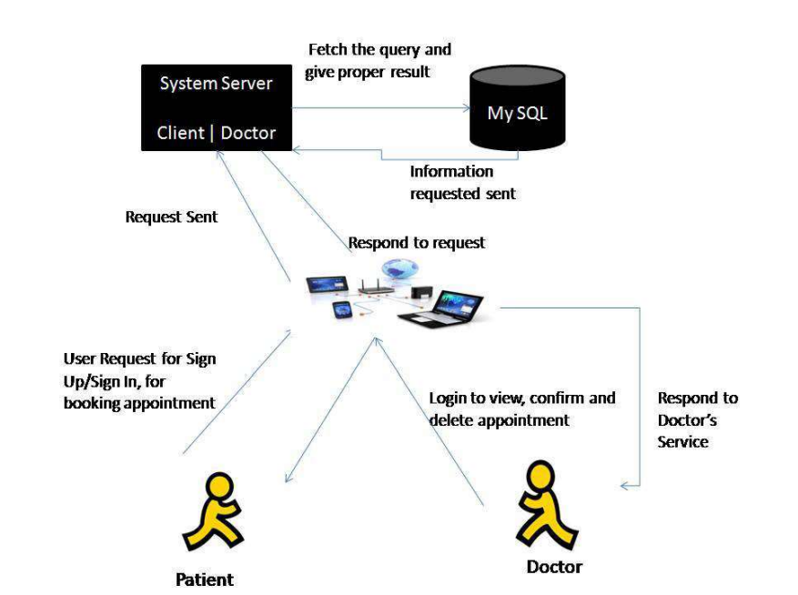
DATA MODELLING

Slide 10
Comparison of views
Patient
Registration & login
Select Doctors
Book Appointment
Attend Appointment
View list of previous Appointment
Doctor
Login into the application
View the patient records
Attend the appointment
Update the Patient Record

Slide 11
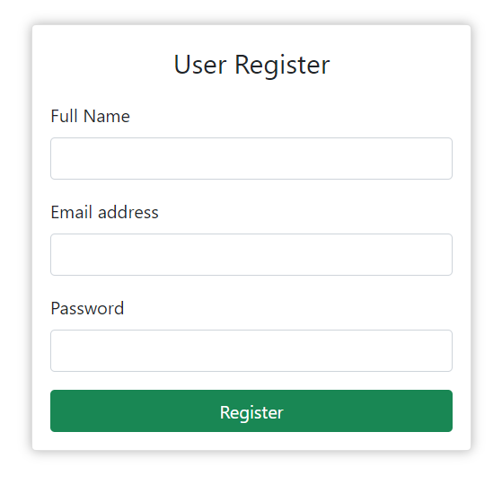
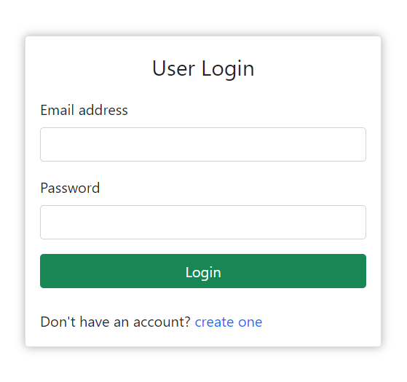
Navigation
User Registration and Login:
User enters their credentials (username and password) on the login page.
The system uses an authentication algorithm to verify the user's identity by comparing the entered credentials with the stored user data.
If the credentials are valid, the user is granted access to their account.

Slide 12
2.Select Doctors:
The user logs in and is directed to the main dashboard.
The system presents a search interface with filtering options based on specialties, locations, availability, and other criteria.
The search and filtering algorithm processes the user's criteria and returns a list of matching doctors.

Slide 13
3.Selecting a Doctor:
Algorithm: Patient-Doctor Matching
The user reviews the list of doctors and selects one based on their preferences and needs.
The system uses a patient-doctor matching algorithm to determine the best available time slots for the selected doctor and the user's preferences.
4.Appointment Scheduling:
Algorithm: Appointment Scheduling
The user selects an available slot for the chosen doctor.
The system checks the availability of the doctor during the chosen date and confirms the appointment if it's available.
If the slot is unavailable, the system might suggest alternative slots or allow the user to choose another doctor.

Slide 14
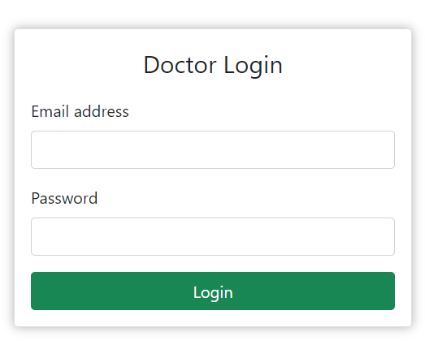
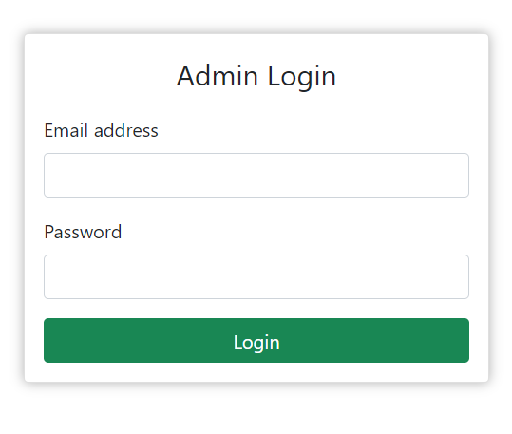
Screens
Doctor Login
Admin Login

Slide 15
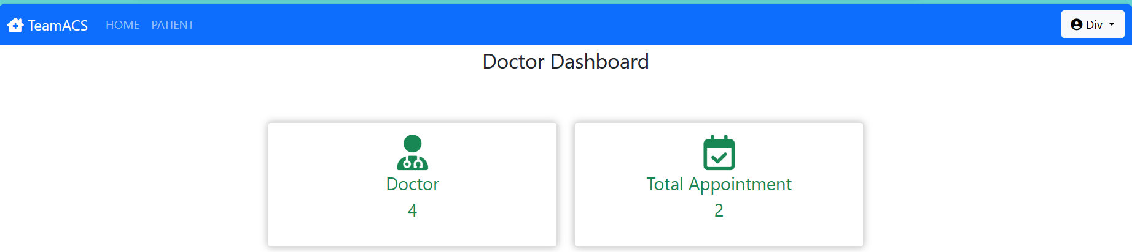
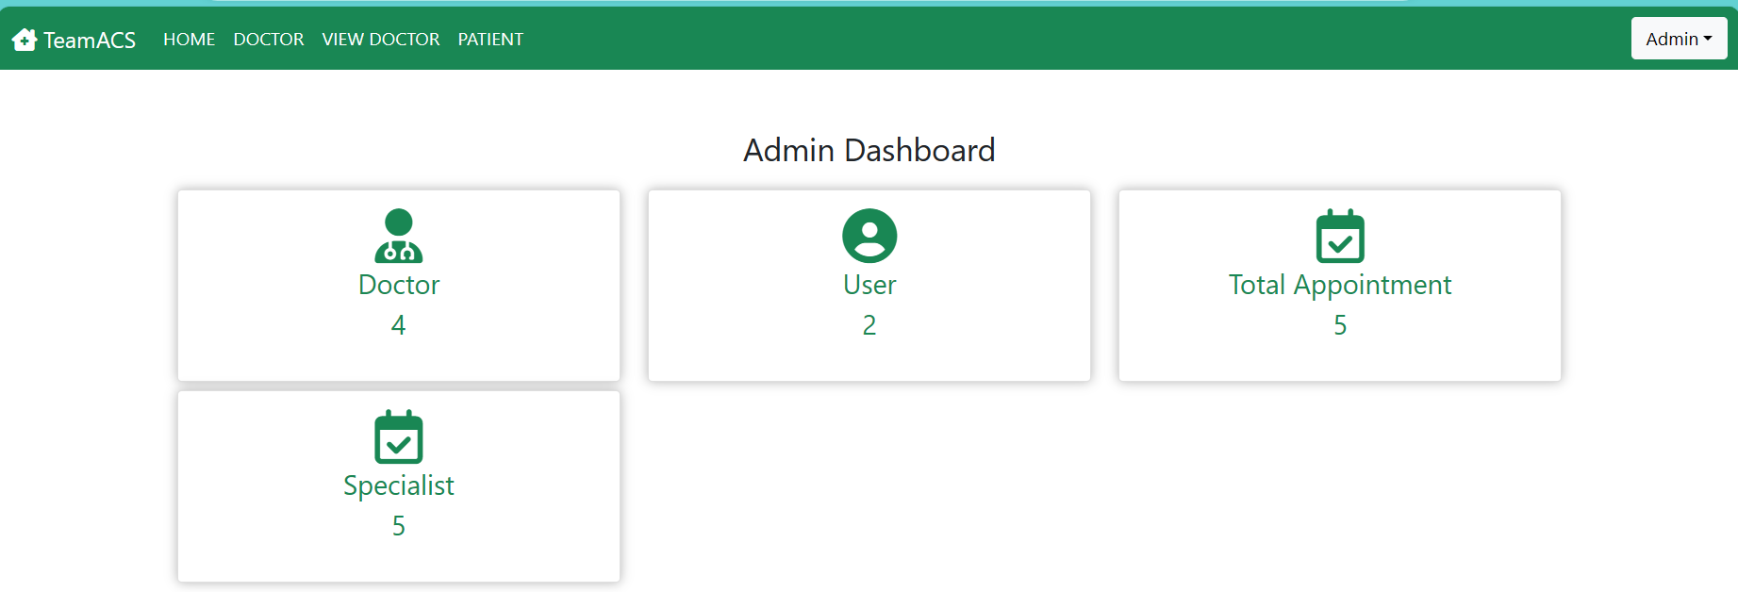
DashBoard
Admin Dashboard
Doctor Dashboard

Slide 16
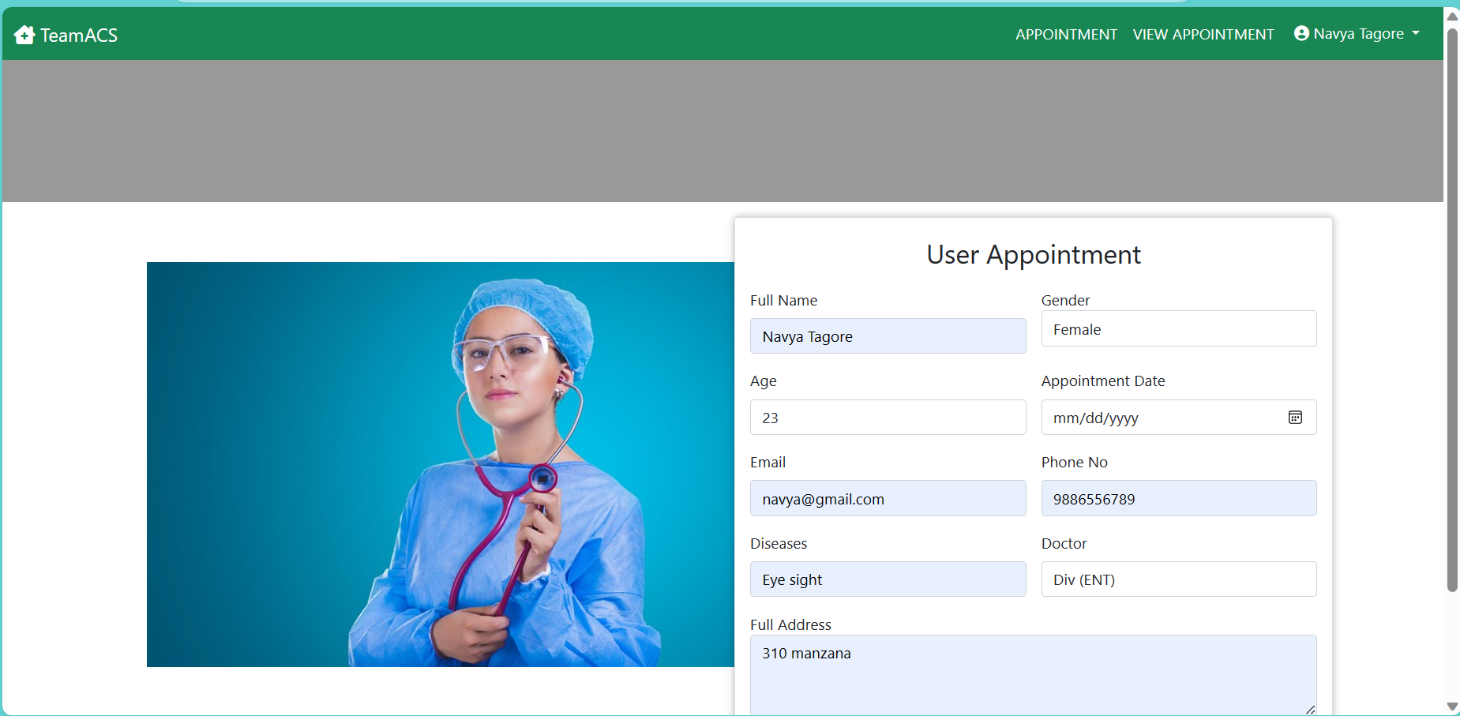
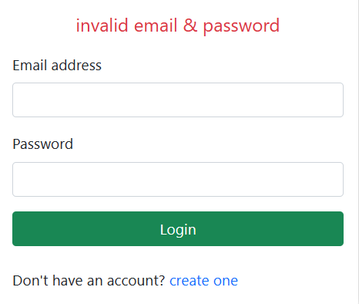
Screens
Book Appointment
Authorization

Slide 17
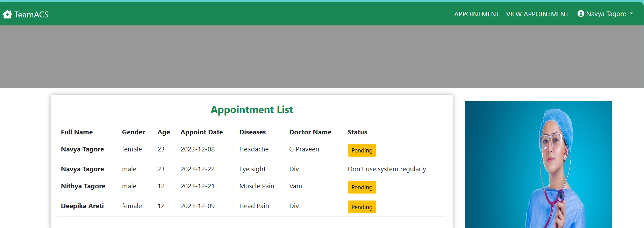
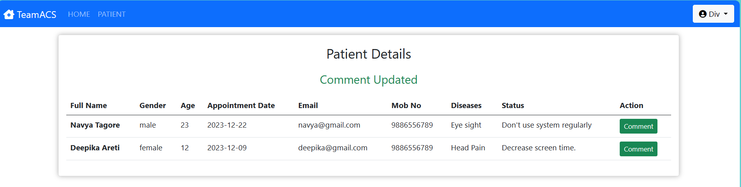
Patient appoint list and patient details screen in doctor

Slide 18
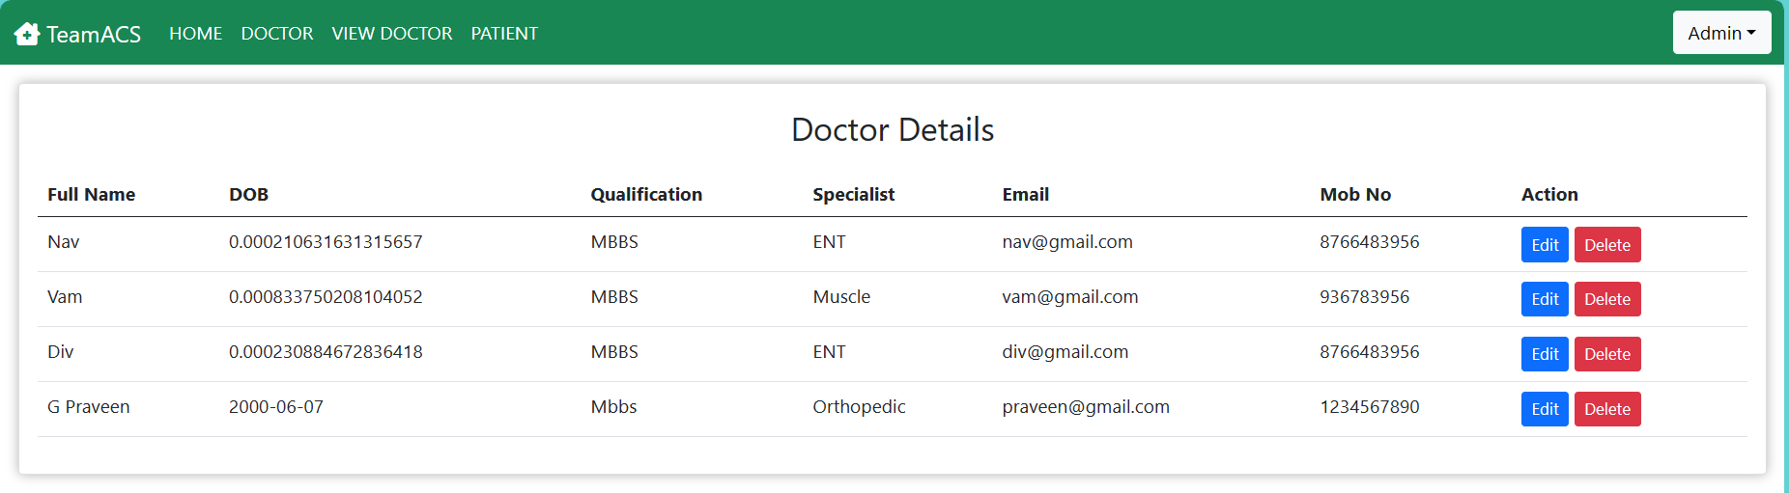
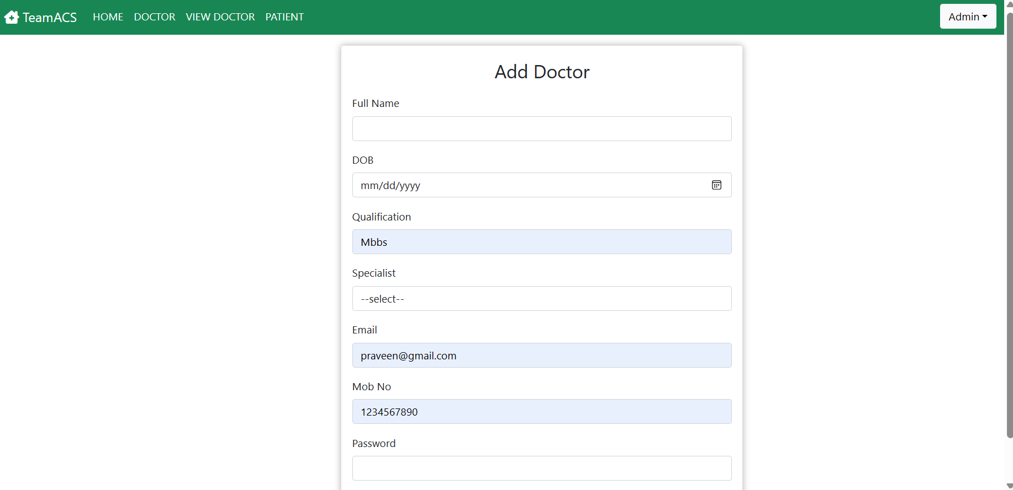
Admin adding Doctor and view the details

Slide 19
CONCLUSION
The Online Doctor Appointment System revolutionizes healthcare access, providing a seamless experience for patients and optimizing doctor-patient interactions. Users can view the information based upon their privilege. We have developed a web based software and will be accessible on any browser. The main motto of the project is to reduce the workload of the healthcare organizations by automation of the appointment booking system.

Slide 20
Future Enhancements
Make the system fully automated.
Implement Notification system to give the alerts regarding the appointments to both patients and doctors
Make the system more flexible for payment different payment methods.
Develop a mobile application.

Slide 21
REFERENCES
https://www.sciencedirect.com/science/article/pii/S1877050923004076
https://link.springer.com/article/10.1007/s10729-018-9459-1
https://scholar.google.com/scholar_lookup?title=Appointment%20Scheduling%20Problem%20in%20Complexity%20Systems%20of%20the%20Healthcare%20Services%3A%20A%20Comprehensive%20Review&publication_year=2022&author=A.%20Ala&author=F.%20Chen

Slide 22


